Slide 1
Computer Networks
CS430

Slide 2
Objectives
Routing protocols
Link state
Distance vector
Intra-AS routing: OSPF
Inter-AS routing: BGP
SDN
SNMP

Slide 3
Network Layer Functions
Forwarding
data plane
move packets from router’s input to appropriate router output
Routing
control plane
determine route taken by packets from source to destination
per-router control
logically centralized control (software defined networking)

Slide 4

Per-router Control Plane
Routing
Algorithm
control
plane
data
plane

Slide 5
Logically Centralized Control
Remote Controller
control
plane
data
plane
CA
CA
CA
CA
CA

Slide 6
Routing Protocols

Slide 7
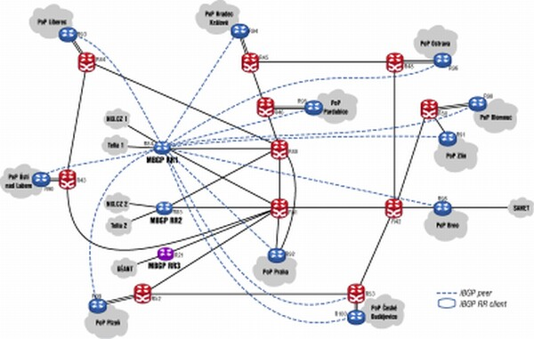
Overview
Routing protocol goal
determine “good” paths through network of routers
Path
sequence of routers from given initial source host to given final destination host
Good path
least “cost”
“fastest”
“least congested”

Slide 8
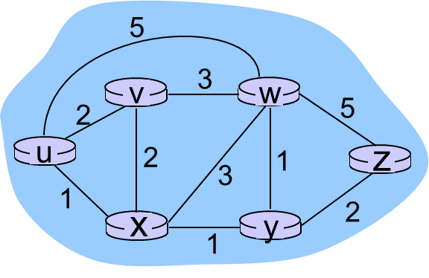
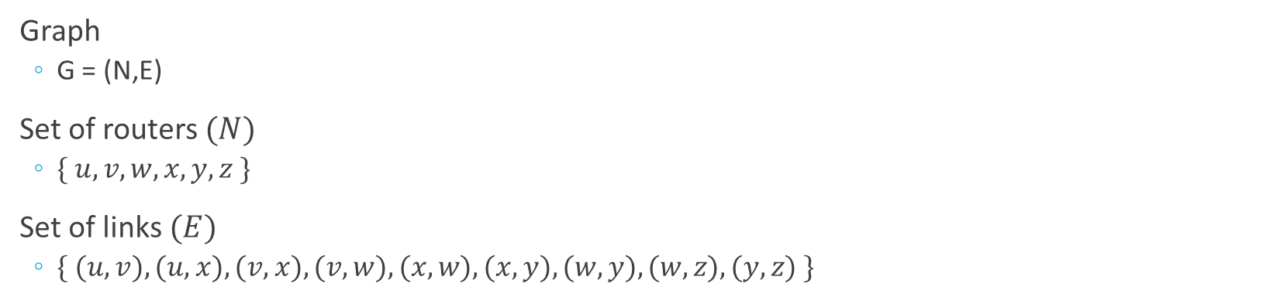
A Bit of Graph Theory
Graph
G = (N,E)
Set of routers $(N)$
$\{ u, v, w, x, y, z \}$
Set of links $(E)$
$\{ (u,v), (u,x), (v,x), (v,w), (x,w), (x,y), (w,y), (w,z), (y,z) \}$

Slide 9
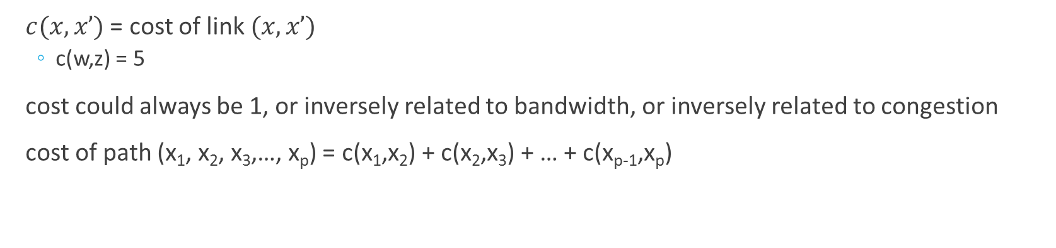
A Bit of Graph Theory
$c(x,x’)$ = cost of link $(x,x’)$
c(w,z) = 5
cost could always be 1, or inversely related to bandwidth, or inversely related to congestion
cost of path (x₁, x₂, x₃,…, x_{p}) = c(x₁,x₂) + c(x₂,x₃) + … + c(x_{p-1},x_{p})

Slide 10
Routing Algorithms
Global vs Decentralized Info
Static vs Dynamic
Global
all routers have complete topology, link cost info
“link state” algorithms
Decentralized
router knows physically-connected neighbors, link costs to neighbors
iterative process of computation, exchange of info with neighbors
“distance vector” algorithms
Static
routes change slowly over time
Dynamic
routes change more quickly
periodic update in response to link cost changes

Slide 11
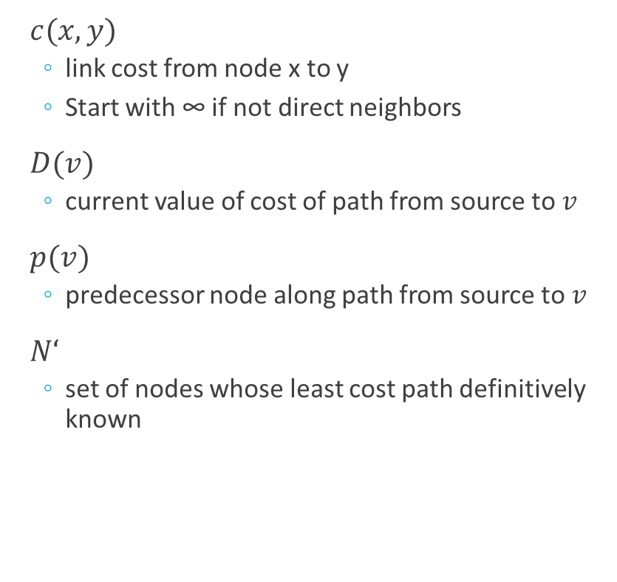
Link-state Routing Algorithm
Dijkstra’s algorithm
Net topology, link costs known to all nodes
accomplished via “link state broadcast”
all nodes have same info
Computes least cost paths from one node (source) to all other nodes
gives forwarding table for that node
Iterative: after k iterations, know least cost path to k destinations
$c(x,y)$
link cost from node x to y
Start with ∞ if not direct neighbors
$D(v)$
current value of cost of path from source to $v$
$p(v)$
predecessor node along path from source to $v$
$N‘$
set of nodes whose least cost path definitively known

Slide 12
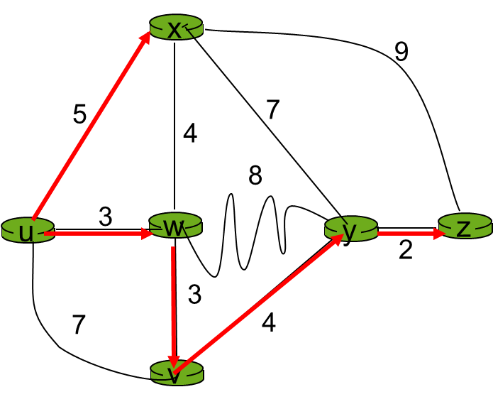
Dijkstra’s Algorithm
1 Initialization:
2 N' = {u}
3 for all nodes v
4 if v adjacent to u
5 then D(v) = c(u,v)
6 else D(v) = ∞
7
8 Loop
9 find w not in N' such that D(w) is a minimum
10 add w to N'
11 update D(v) for all v adjacent to w and not in N' :
12 D(v) = min( D(v), D(w) + c(w,v) )
13 /* new cost to v is either old cost to v or known
14 shortest path cost to w plus cost from w to v */
15 until all nodes in N'

Slide 13
Dijkstra’s Algorithm
D(v)
p(v)
D(w)
p(w)
D(x)
p(x)
D(y)
p(y)
D(z)
p(z)
Step
N'
0
u
7,u
3,u
5,u
∞
∞
1
uw
6,w
5,u
11,w
∞
2
uwx
6,w
11,w
14,x
3
uwxv
10,v
14,x
4
uwxvy
12,y
5
uwxvyz

Slide 14
Dijkstra’s Algorithm
N'
u
ux
uxy
uxyv
uxyvw
uxyvwz
D(v),p(v)
2,u
2,u
2,u
D(w),p(w)
5,u
4,x
3,y
3,y
D(x),p(x)
1,u
D(y),p(y)
∞
2,x
D(z),p(z)
∞
∞
4,y
4,y
4,y

Slide 15
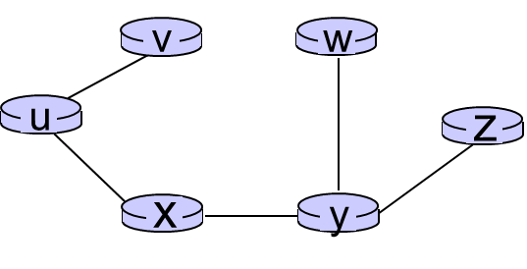
Dijkstra’s Algorithm
Shortest-path Tree
Forwarding Table
Destination | Link
v | (u,v)
x | (u,x)
y | (u,x)
w | (u,x)
z | (u,x)

Slide 16
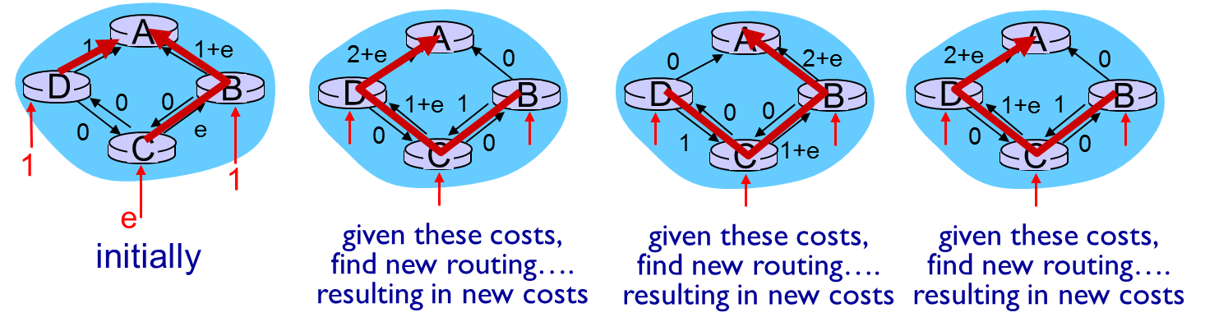
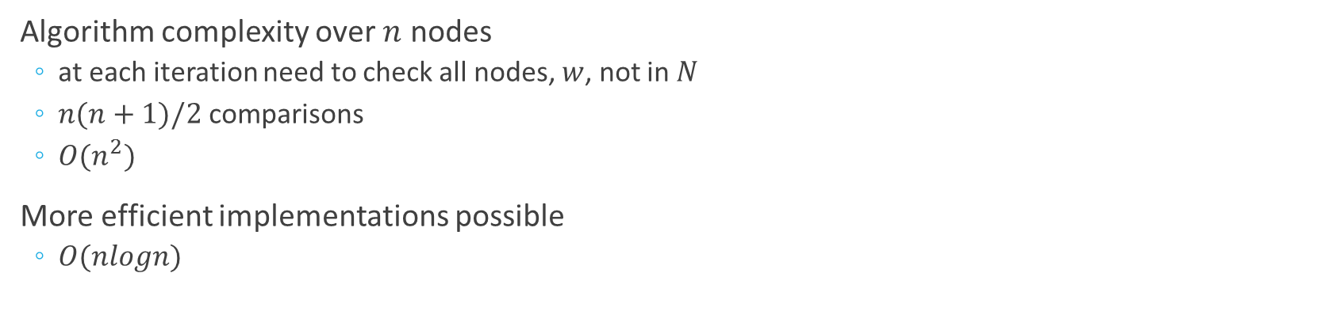
Dijkstra’s Algorithm
Algorithm complexity over $n$ nodes
at each iteration need to check all nodes, $w$, not in $N$
$n(n+1)/2$ comparisons
$O(n^{2})$
More efficient implementations possible
$O(nlogn)$

Slide 17

Distance Vector Algorithm
Bellman-Ford equation (dynamic programming)
$d_{x}(y)$ := cost of least-cost path from x to y
$d_{x}(y) \underset{v}{=min}{\{c\left(x,v\right)+d_{v}\left(y\right)\}}$
$\min_{v}{\{…\}}$
Min over all neighbors $v$ of $x$
$c(x,v)$
Cost to neighbor $v$
$d_{v}(y)$
Cost from neighbor $v$ to destination $y$

Slide 18
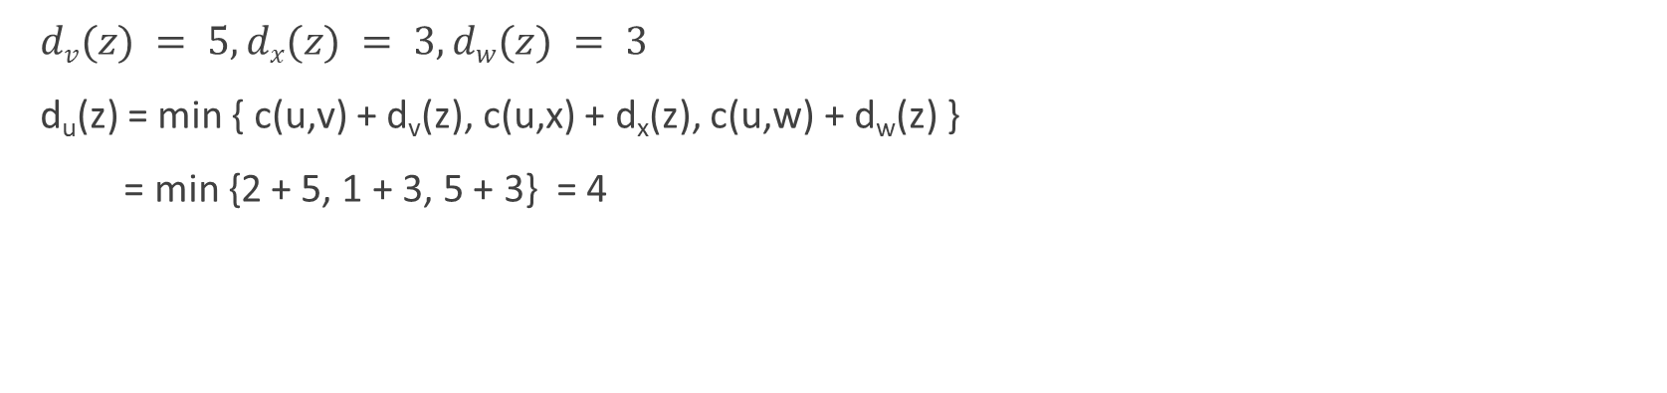
Bellman-Ford Example
$dv(z) = 5, dx(z) = 3, dw(z) = 3$
d_{u}(z) = min { c(u,v) + d_{v}(z), c(u,x) + d_{x}(z), c(u,w) + d_{w}(z) }
= min {2 + 5, 1 + 3, 5 + 3} = 4

Slide 19
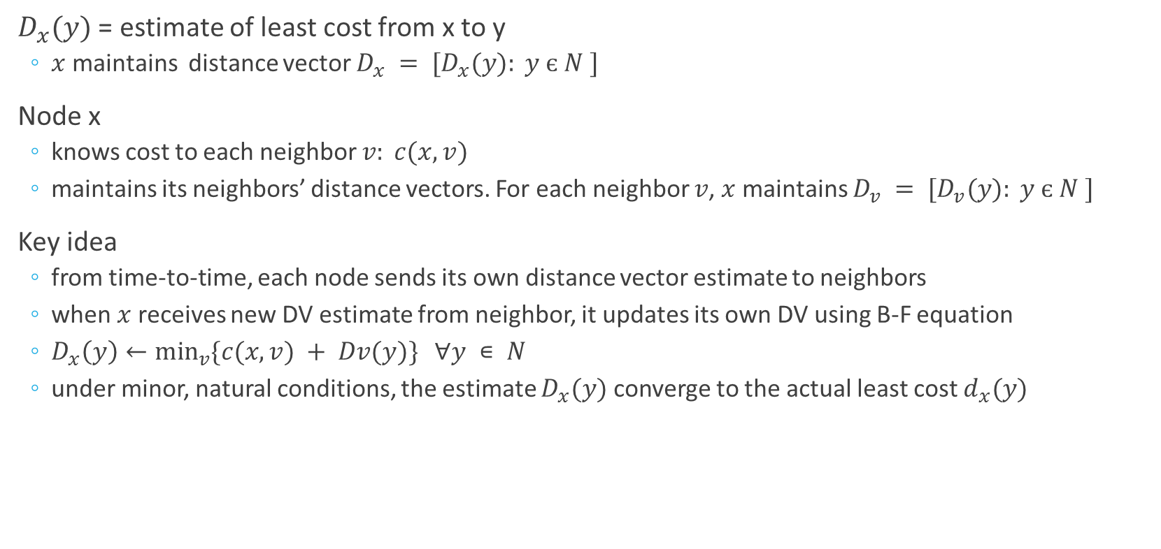
Distance Vector Algorithm
$D_{x}(y)$ = estimate of least cost from x to y
$x$ maintains distance vector $D_{x} = [D_{x}(y): y є N ]$
Node x
knows cost to each neighbor $v: c(x,v)$
maintains its neighbors’ distance vectors. For each neighbor $v$, $x$ maintains $D_{v} = [D_{v}(y): y є N ]$
Key idea
from time-to-time, each node sends its own distance vector estimate to neighbors
when $x$ receives new DV estimate from neighbor, it updates its own DV using B-F equation
$D_{x}\left(y\right)←\min_{v}{\{c(x,v) + Dv(y)\}} ∀y ∊ N$
under minor, natural conditions, the estimate $D_{x}(y)$ converge to the actual least cost $d_{x}(y)$

Slide 20
Distance Vector Algorithm
Iterative, asynchronous
Each local iteration caused by
local link cost change
DV update message from neighbor
Distributed
each node notifies neighbors only when its DV changes
neighbors then notify their neighbors if necessary
Node process
wait for (change in local link cost or message from neighbor)
recompute estimates
if DV to any destination has changed, notify neighbors

Slide 21
D_{x}(z) = min{c(x,y) + D_{y}(z), c(x,z) + D_{z}(z)}
= min{2+1 , 7+0} = 3
D_{x}(y) = min{c(x,y) + D_{y}(y), c(x,z) + D_{z}(y)} = min{2+0 , 7+1} = 2
node x
table
cost to
cost to
x y z
x y z
x
0 2 7
x
0
2
3
y
y
2 0 1
from
∞
∞
∞
from
z
∞
∞
∞
z
7 1 0
node y
table
cost to
x y z
y
2
1
x
∞
∞
z
∞
2 0 1
x
from
y
7
z
∞
∞
∞
node z
table
cost to
x y z
x
∞ ∞ ∞
from
y
∞
∞
∞
z
7
1
0
time

Slide 22
D_{x}(z) = min{c(x,y) + D_{y}(z), c(x,z) + D_{z}(z)}
= min{2+1 , 7+0} = 3
D_{x}(y) = min{c(x,y) + D_{y}(y), c(x,z) + D_{z}(y)} = min{2+0 , 7+1} = 2
node x
table
cost to
cost to
cost to
x y z
x y z
x y z
x
0 2 7
x
0
2
3
x
0 2 3
y
y
2 0 1
from
∞
∞
∞
from
y
2 0 1
z
z
from
∞
∞
∞
7 1 0
z
3 1 0
node y
table
cost to
cost to
cost to
x y z
x y z
x y z
y
2
1
x
∞
∞
x
0 2 7
∞
2 0 1
x
0 2 3
x
z
from
y
y
2 0 1
y
7
from
from
2 0 1
z
∞
∞
∞
z
7 1 0
z
3 1 0
node z
table
cost to
cost to
cost to
x y z
x y z
x y z
x
∞ ∞ ∞
x
0 2 7
x
0 2 3
y
y
2 0 1
from
y
∞
∞
from
2 0 1
from
∞
z
z
3 1 0
z
3 1 0
7
1
0
time

Slide 23
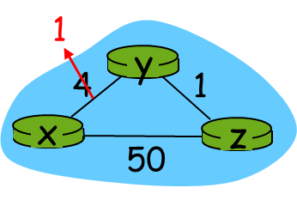
Distance Vector: Link Cost Changes
Link cost changes
node detects local link cost change
updates routing info, recalculates DV
if DV changes, notify neighbors
Good news travel fast
t₀ : y detects link-cost change, updates its DV, informs its neighbors
t₁ : z receives update from y, updates its table, computes new least cost to x , sends its neighbors its DV
t₂ : y receives z’s update, updates its distance table. y’s least costs do not change, so y does not send a message to z

Slide 24
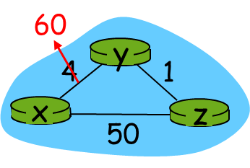
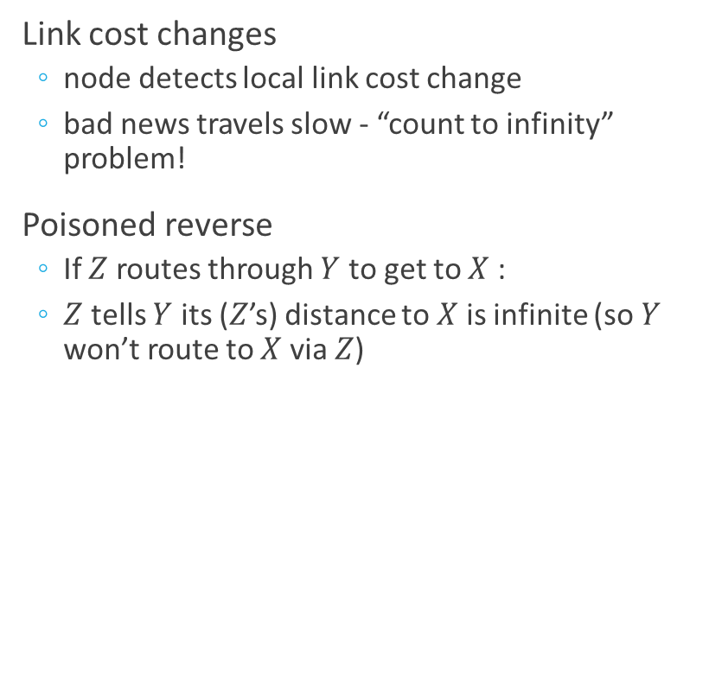
Distance Vector: Link Cost Changes
Link cost changes
node detects local link cost change
bad news travels slow - “count to infinity” problem!
Poisoned reverse
If $Z$ routes through $Y$ to get to $X$ :
$Z$ tells $Y$ its ($Z$’s) distance to $X$ is infinite (so $Y$ won’t route to $X$ via $Z$)

Slide 25
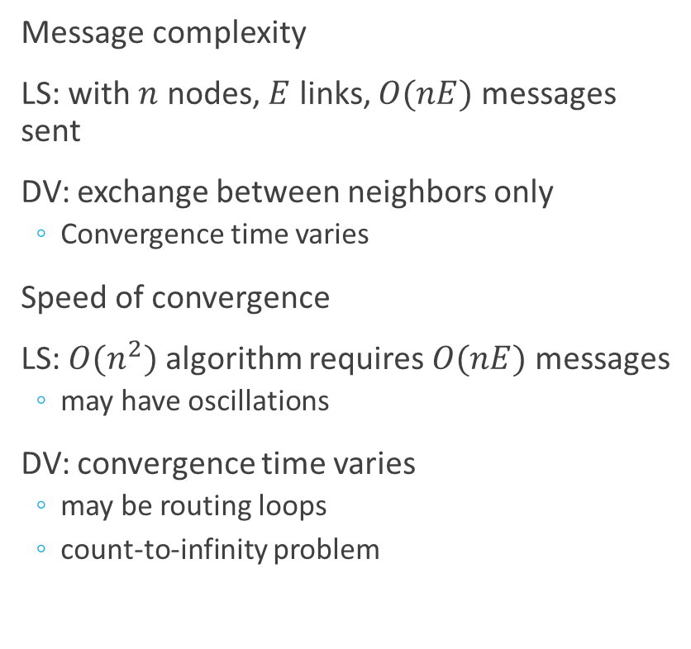
Algorithm Comparison
Message complexity
LS: with $n$ nodes, $E$ links, $O(nE)$ messages sent
DV: exchange between neighbors only
Convergence time varies
Speed of convergence
LS: $O(n^{2})$ algorithm requires $O(nE)$ messages
may have oscillations
DV: convergence time varies
may be routing loops
count-to-infinity problem
Robustness
what happens if router malfunctions?
LS:
node can advertise incorrect link cost
each node computes only its own table
DV:
DV node can advertise incorrect path cost
each node’s table used by others
error propagate thru network

Slide 26
Routing Protocols

Slide 27
Hierarchical Routing
Autonomous system (AS)
A group of routers under the same control
Gateway Protocols
Interior and Exterior
Routing inside an AS
Hot-potato routing
Enhanced Interior Gateway Routing Protocol (EIGRP)
Routing Information Protocol (RIPv2)
Open Shortest Path First (OSPF)
Intermediate System to Intermediate System (IS-IS)
Routing outside an AS
Policies and metrics
Border Gateway Protocol (BGP)

Slide 28
Open Shortest Path First
Open Shortest Path First (RFC 2328)
Broadcasts changes in routing information within AS
Transport layer (Protocol 89)
Optional authentication
MD5
Multiple paths
Unicast and multicast routing
Hierarchical AS
Link-state advertisements to all routers in an area
Cost (connection-specific)

Slide 29
OSPF Hierarchy
boundary router
backbone router
backbone
area
border
routers
area 3
internal
routers
area 1
area 2

Slide 30
OSPF
An OSPF router forms adjacencies with neighbors
Hello exchange
Builds adjacencies database
Dijkstra’s Shortest Path First algorithm to find the best path
Each router sees itself as the central point from which a loop-free, best-cost path to each network is determined

Slide 31
OSPF Operations
Type | Name | Function
1 | Hello | Neighbor discovery and adjacency maintenance
2 | DB Description | Topological DB summary
3 | LS Request | Request LS info from a neighbor’s DB
4 | LS Update | Advertise available links via network flooding
5 | LS Ack | Response to LS Update

Slide 32
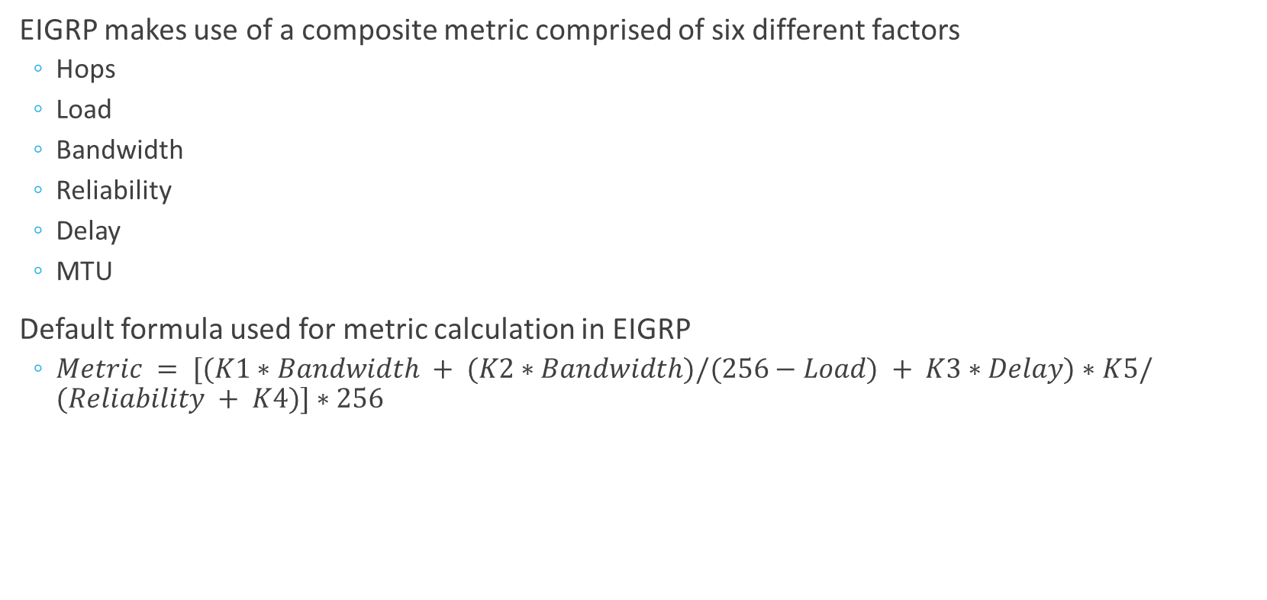
EIGRP
EIGRP makes use of a composite metric comprised of six different factors
Hops
Load
Bandwidth
Reliability
Delay
MTU
Default formula used for metric calculation in EIGRP
$Metric = [(K1∗Bandwidth + (K2∗Bandwidth)/(256−Load) + K3∗Delay)∗K5/(Reliability + K4)]∗256$

Slide 33
EIGRP Components
Protocol Dependent Modules
Neighbor discovery and maintenance
224.0.0.10
Hello with timeouts
Reliable Transport Protocol
Cisco’s own layer 4 protocol
Can provide both reliable and unreliable delivery
Diffusing Update Algorithm (DUAL)
Quick outage recovery

Slide 34
Border Gateway Protocol
BGP is a complex protocol
BGP is a very complex protocol
Used to glue together autonomous systems
eBGP
obtain subnet reachability information from neighboring ASs.
iBGP
propagate reachability information to all AS-internal routers.
AS determines “good” routes to other networks based on reachability information and policy
Allows advertisement of a subnet existence

Slide 35
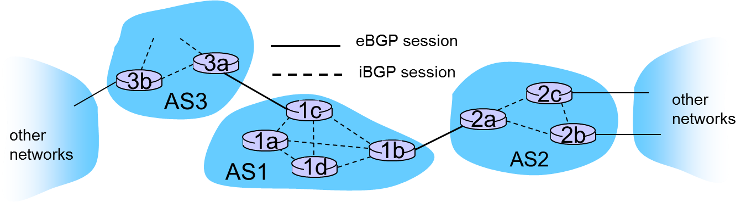
BGP Basics
TCP connection (port 179)
BGP session
Two peers exchange information about reachable networks
Prefix advertisement means a promise to forward

Slide 36
BGP Attributes
Autonomous System Number
Globally unique AS identifier
AS-PATH
Systems through which prefix advertisement has passed
NEXT-HOP
Used by routers to configure forwarding tables
Policy-based routing
Do not route through certain AS

Slide 37
Route Selection
Local preference
Policy
Shortest AS-PATH
DV algorithm
Closest NEXT-HOP
Smallest least-cost path, as determined by IGP
Hot-potato touting
Additional criteria

Slide 38
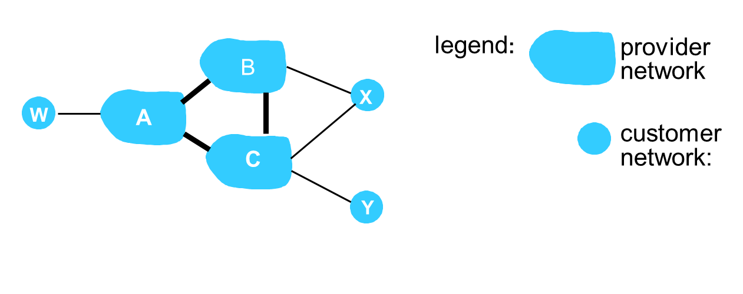
BGP Routing Policy
X does not want to route from B via X to C
X will not advertise to B a route to C
Should B advertise path BAW to C?
It depends

Slide 39
Why Different Intra-, Inter-AS Routing ?
Policy
Inter-AS: admin wants control over how its traffic routed, who routes through its net.
Intra-AS: single admin, so no policy decisions needed
Scale
hierarchical routing saves table size, reduced update traffic
Performance
Intra-AS: can focus on performance
Inter-AS: policy may dominate over performance

Slide 40
Simple Network Management Protocol

Slide 41
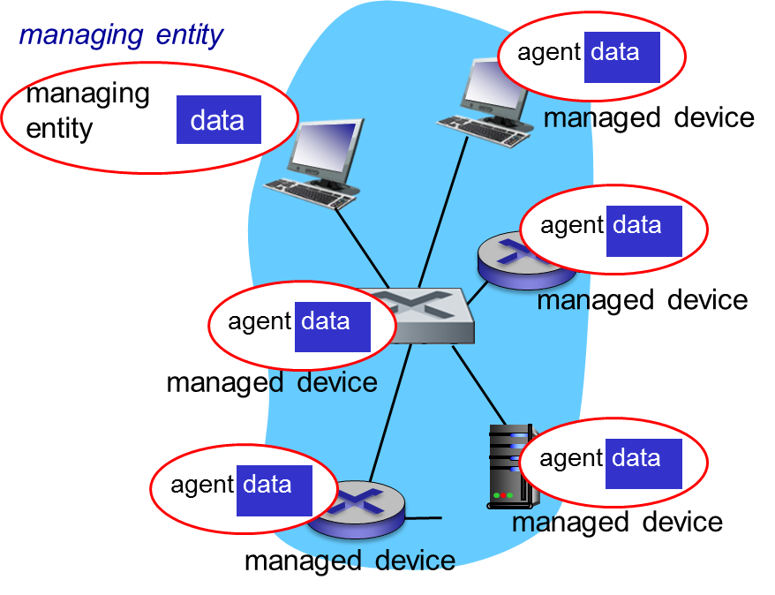
Network Management
Managed devices
contain managed objects
Object data is gathered
Management Information Base (MIB)

Slide 42
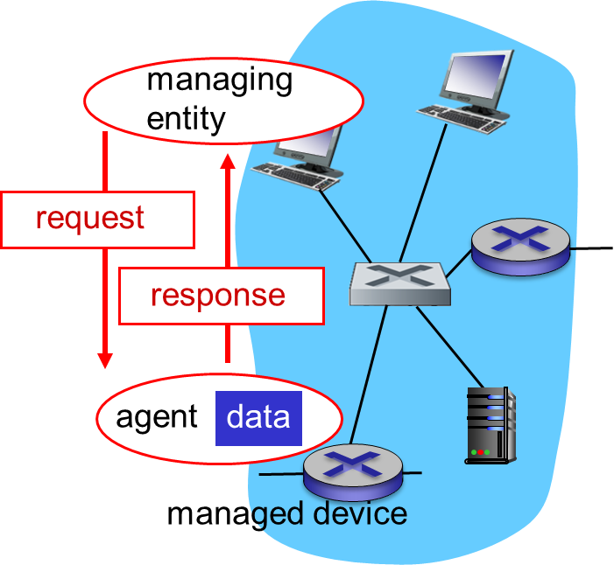
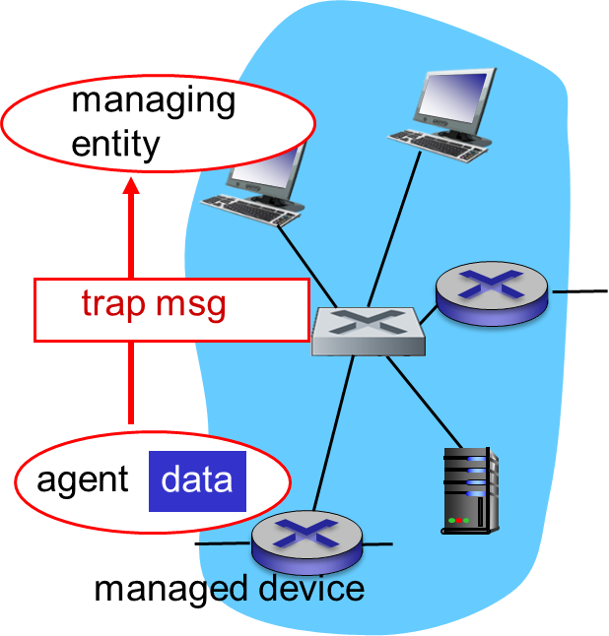
Simple Network Management Protocol
Request/response Mode
Trap Mode

Slide 43
Simple Network Management Protocol
Message | Function
GetRequest GetNextRequest GetBulkRequest | manager-to-agent: “get me data” (data instance, next data in list, block of data)
InformRequest | manager-to-manager: here’s MIB value
SetRequest | manager-to-agent: set MIB value
Response | Agent-to-manager: value, response to Request
Trap | Agent-to-manager: inform manager of exceptional event

Slide 44
Generalized Forward and SDN

Slide 45
Summary
Routing protocols
Link state
Distance vector
Intra-AS routing: OSPF
Inter-AS routing: BGP
SDN
SNMP

Slide 46
Thank You!

